Slide 1

MyCrobIQ
Your other genome unlocked, and how you can change together

Slide 2
Team
Steive Clemens
Drashti Mehta
Thao My Nguyen
Michael Rosenfeld
Competitive Analysis
Industry Description and Outlook
Target Market
Regulatory restrictions and requirements

Slide 3

The problem
“The most difficult thing in life is to know yourself” - Thales
DNA, while foundational is largely immutable
The gut Microbiome however, is mutable, and will change over time with diet and lifestyle changes

Slide 4

The solution - The MyCrobIQ kit
A kit that takes the users sample in an easy to use system, use the widely trusted 16s amplicon sequencing platform to give them insights into what their gut microbiome can mean to them
Unlike our competitors we offer a system focused on growing with the user, tracking the changes of their microbiome as they go through life

Slide 5

The Science
Our kit uses 16s Amplicon Sequencing
The gut microbiome has shown links to mental health, obesity, and diabetes among other concerns
Analysis of the results when compared with the demographics of the users will give us more data about what each microbiome state is for that group and thus we can tell them more over time

Slide 6

The Amplicon Sequencing method using PCR
Primer
DNA
Primer
Amplified DNA

Slide 7
Industry Description
This industry is very new and falls under the Education and Health Service Sector, specifically Microbiome Therapeutics.
Microbiome at-home test kits (available OTC) are becoming particularly popular because of the onset of the global Covid-19 pandemic and hence the social distancing.
 | 2021 | 2026 | CAGR
Global Market | 141.7 million | 1.3 billion | 56.4%
Infectious Disease segment | 53.8 million | 191.8 million | 28.9%

Slide 8
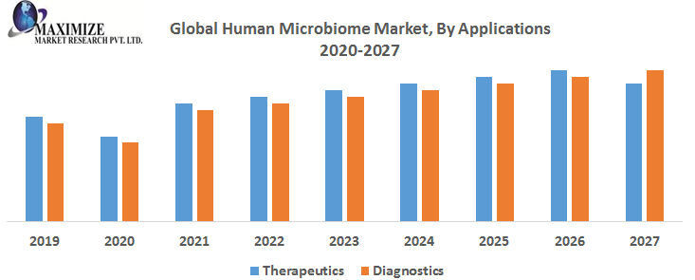
Reference: Maximize Market Research Pvt. Ltd. (Aug 2019) https://www.maximizemarketresearch.com/market-report/global-human-microbiome-market/33879/

Slide 9
The Regional Aspect of Market
The North American region is expected to dominate the gut microbiome testing market in the coming years promising better patient outcomes.
The increasing population, existence of prominent players, and regulatory approvals from the U.S. FDA is driving this market’s growth in the region.
Europe and Asia Pacific are expected to grow significantly during the forecast timeline due to the extensive research activity and rising investment in technologically advanced gut microbiome testing equipment in the region.

Slide 10

The Target Market
Individuals with health conditions that linked with microbiome health
Healthy individuals who wonder if their diet plan are efficient
Improve quality of life
Change diet plan
Modify exercise plan

Slide 11
Competitor Analysis
Viome - Microbiome sequencing kit using transcriptome sequencing, personal care products,single test kit, higher price per kit
GutMicrobiome+ - Whole Genome Sequencing, single test kit, higher price per kit

Slide 12
The Regulations
FDA:
We aren’t a medical device, but…
Precedent set by 23andMe when began testing for genetic diseases
What if MycrobIQ ends up in a similar situation?
FDA: De Novo Classification request for Medical Device
Aiming for Class 1
May have to follow special regulations set by the FDA
No Predicates anywhere on the market
OSHA:
Need a clean and secure facility to conduct genomic testing
Occupational Exposure to Hazardous Chemicals in Laboratories standard (29 CFR 1910.1450)
Clinical Laboratory Improvement Amendments of 1988

Slide 13
Why us?
Our service is offered at a lower price per kit than our competitors while offering superior information about the bacteria in your gut microbiome due to the multiple samples analyzed over time

Slide 14

Conclusion
MyCrobIQ is a tool to allow its users to learn more about their own inner-workings and provide them with concrete results as to how they are changing it

Slide 15
References
Dublin (2018). Global $928 Million Consumer DNA (Genetic) Testing Market 2018-2023 with 23andMe, Ancestry, Color Genomics and Gene by Gene Dominating. Research andMarkets,from https://www.prnewswire.com/news-releases/global-928-million-consumer-dna-genetic-testing-market-2018-2023-with-23andme-ancestry-color-genomics-and-gene-by-gene-dominating-300640236.html
Gupta, S., Mortensen, M.S., Schjørring, S. et al.,(2019). Amplicon sequencing provides more accurate microbiome information in healthy children compared to culturing. Community Biology (2), 291. https://doi.org/10.1038/s42003-019-0540-1
Himanshu,V and Deshmukh, R (2021). “Weight Loss and Weight Management Diet Market Size, Share,and Trends.” Allied Market Research,from https://www.alliedmarketresearch.com/weight-loss-management-diet-market.
Accion Opportunity Fund (Refered on November 10th, 2021) https://aofund.org/resource/business-plan-section-5-market-analysis/
Emergen Reserach (Oct 2020) https://www.emergenresearch.com/industry-report/gut-microbiome-test-market
Sarah Greenberg, (Jun 24, 2021) https://blog.bccresearch.com/diy-microbiome-testing-market-trends-you-need-to-know-with-interview

Slide 16
Questions?

